Slide 1
Problem: right or wrong hides how students think
One wrong answer can come from very different reasoning.
1/2 + 1/3 → 2/5
marked wrong
A "Added tops and bottoms"
B "Slipped on the common denominator"
C "Not sure why"
Misconception
Calculation slip
Too little evidence
Limits of right/wrong
Research gap
Our direction
Same answer, different causes
Student reasoning is discarded
Misconception and slip look identical
Correctness alone leaves the reason unobserved
One-off judgments may not retain earlier evidence
A traceable, revisable concept state needs study
Treat explanations as evidence
Link each piece to one concept
Keep a persistent, revisable learner state
Language-Grounded Learner State Modeling for Misconception-Aware Adaptive Learning
Research question: can students' own language give reliable, concept-grounded evidence that a persistent learner state can use?
Notes:
Sources: Language_Grounded_Persistent_Learner_State_Research.md; Language_Grounded_Learner_State_Modeling_PRD.md. The response examples are illustrative. Research question and hypotheses remain untested.

Slide 2
Phase 2: what we have built
A working assessment website; NLP, retrieval, AI and memory run behind it.
Student website
React + Vite
NLP processing
clean, tokens
Retrieval (RAG)
FTS5 + BM25
GPT-4.1-mini
structured output
Cognitive Evidence
checked, grounded
Learner state
versioned memory
Next question
Repair to Transfer
NLP Observability records available execution stages, failures and retries
Website
Backend
Data and memory
Assessment chat and saved drafts
Evidence inspector and reports
Observability and response history
Topic memory across conversations
FastAPI v2 + AssessmentService
Bounded retries and recovery
Trace, history and research APIs
Annotation evaluation runner
SQLite WAL: answers, evidence and snapshots
FTS5 index for notes and evidence
Local learner/topic scope
Notes:
Sources: README.md; docs/NLP_CONCEPTS_IMPLEMENTATION_AND_JUSTIFICATION.md; apps/api/app/main.py. Journal recording is best effort and prior historical records do not gain invented stage events.

Slide 3
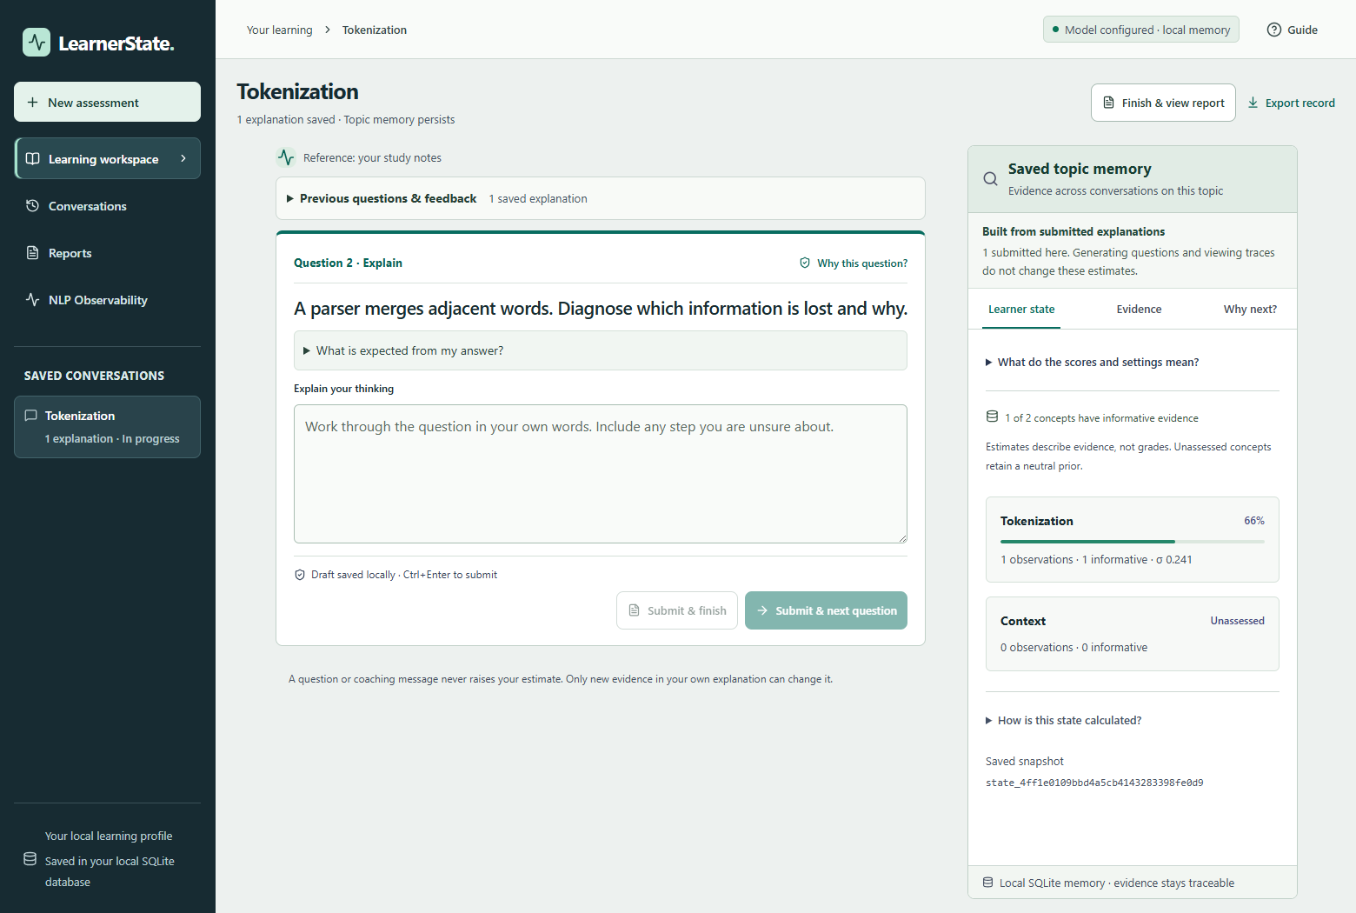
Platform architecture and the student workflow
The website, pipeline and database work as one connected system.
Ask
Question from saved topic and rubric
Answer
Student writes an explanation
Process
NLP, retrieval, AI, checks
Remember
Evidence and state saved together
Respond
Feedback; coaching kept apart
Plan
Next question targets the gap
Architecture layers
React 19 + Vite: chat, inspector, reports, Observability
FastAPI v2 API + AssessmentService
NLP · retrieval · AI provider · validation · state · planner
SQLite (WAL) data + separate trace journal
Learning workspace, fixture verification
Notes:
Sources: README.md; apps/web/src/components/AssessmentWorkspace.tsx; packages/learner_state_core/assessment/service.py. Screenshot: docs/verification/workspace-feedback/recovery/fixture/learning-desktop.png. Fixture verification uses synthetic data.

Slide 4
NLP preprocessing: original text preserved
Clean views for features; the student's original text stays the source of truth.
Synthetic test response, processed
What each step does
"I multiply both numerator and denominator by the same nonzero number, so their ratio stays unchanged…"
Unicode NFKC + whitespace: separate normalized view
Regex tokens: retain math symbols and decimal numbers; fraction slash is separate
Sentence spans: retain original offsets and newlines
Lexical features: keywords, negation and uncertainty cues
Porter stemming: applied by the FTS5 index
Token spans: word and original character offsets
I
0–1
multiply
2–10
both
11–15
numerator
16–25
46 tokens in this run
Keywords: both, numerator, multiplying, denominator, ratio, nonzero…
Negation and uncertainty cues: none found
Not used in v2: POS tagging, parsing, general NER, n-grams, subword or embedding stages.
Notes:
Source: packages/learner_state_core/assessment/nlp.py; docs/NLP_CONCEPTS_IMPLEMENTATION_AND_JUSTIFICATION.md. Numeric decimals are tokens; mathematical operators including a fraction slash are preserved as separate spans. Source offsets always refer to original text.

Slide 5
Retrieval (RAG) with FTS5 and BM25
Retrieved material grounds the prompt; prior learner evidence remains diagnostic context.
Sources
notes, reference, past evidence
Chunking
overlapping character ranges
FTS5 index
Porter + Unicode61 inverted index
BM25 ranking
best lexical match first
To the AI
top passages in the prompt
How it supports interpretation
Retrieval in a synthetic live run
Scoped to the learner, topic and selected source
Study material supplies factual context for interpretation
Prior evidence supports continuity and contradiction checks
Lexical mismatch triggers a recorded recent-passage fallback
Query: "Fraction Definition…" from the question concept
Method: FTS5 · Porter · BM25
Found: study notes on equivalent fractions
Rank: −7.3e-06 (smaller sorts first; not a probability)
Lexical retrieval only. Dense-vector retrieval and embeddings are not used in v2.
Notes:
Sources: packages/learner_state_core/assessment/storage.py and nlp.py; docs/LEARNER_STATE_PIPELINE.md. FTS5 uses porter unicode61 and BM25. Ranking scores are not confidence. No dense retrieval is active in v2.

Slide 6
LLM extraction with strict validation
The AI proposes structured evidence; fixed code decides whether it is accepted.
Inputs
Question + rubric
Student response
Retrieved passages
Prior learner state
GPT-4.1-mini
Instructor + Pydantic
Temperature 0.2
Structured output
Exact source quote
Claim and category
Criteria met / missing
Misconception, citations
Deterministic checks
Quote is in the answer
Rubric parts complete
Citations allowed
Contradiction IDs exist
If a check fails
One synthetic live run
Retry once, naming the failed check
After two attempts: an error and no state update
No canned or invented fallback in v2
Keys and provider error bodies are never stored
3,815
about 3.2 s
max 2
tokens used
AI step
attempts
A valid quote shows where text came from, not that the model understood it correctly.
Notes:
Sources: packages/learner_state_core/assessment/provider.py and models.py; docs/NLP_CONCEPTS_IMPLEMENTATION_AND_JUSTIFICATION.md. One synthetic live execution shows provider usage and latency; these are not a benchmark. Quote validation establishes provenance, not semantic correctness.

Slide 7
Cognitive Evidence and concept grounding
A structured, source-linked note of what the student showed.
Evidence field | Recorded in the real run
Concept | fraction_definition
Quote | Exact text span [0:231], verified
Claim | Same multiplier on both parts keeps the ratio
Met | understand_ratio, use_example
Missing | relate_part_whole
Misconception | None found in this run
Category | Partial
Confidence | 0.7, uncalibrated
Concept grounding
Only the question's saved concept ID is accepted
Checked against the topic map and prerequisites
Topic map is model-made, not expert-verified
Provenance
Question → answer → trace → evidence → state snapshot, linked by IDs
Stored quote equals the original text
Notes:
Sources: packages/learner_state_core/assessment/models.py and service.py; docs/LEARNER_STATE_PIPELINE.md. The example comes from a synthetic live run. The question target constrains concept identity, and the topic map is model-authored.

Slide 8
Persistent learner state: weighted memory
Informative evidence updates a saved, versioned estimate.
How one answer updates memory
Synthetic run: 2 of 3 criteria met
Parameter | Before | After
Alpha | 1.000 | 1.467
Beta | 1.000 | 1.233
Estimate | 0.500 | 0.543
Uncertainty | 0.289 | 0.259
Weight w = confidence × novelty × min(tokens/16, 1)
Coverage criteria met ÷ all criteria
Alpha α′ = α + w × coverage
Beta β′ = β + w × (1 − coverage) × slip factor
Estimate α′ ÷ (α′ + β′)
Uncertainty is computed from the current Beta parameters.
Heuristic evidence values, not calibrated understanding.
Duplicate damping
repeat answers weigh less
Abstention
vague or short evidence holds numbers
Coaching excluded
only learner responses update memory
Contradictions
explicit evidence can weaken a hypothesis
Each update is a versioned snapshot, committed atomically with the answer and evidence.
Notes:
Sources: packages/learner_state_core/assessment/state.py; docs/LEARNER_STATE_PIPELINE.md. Beta values and confidence are engineering heuristics, not calibrated probabilities of understanding. Ambiguous, short or low-confidence responses can leave numeric state unchanged.

Slide 9
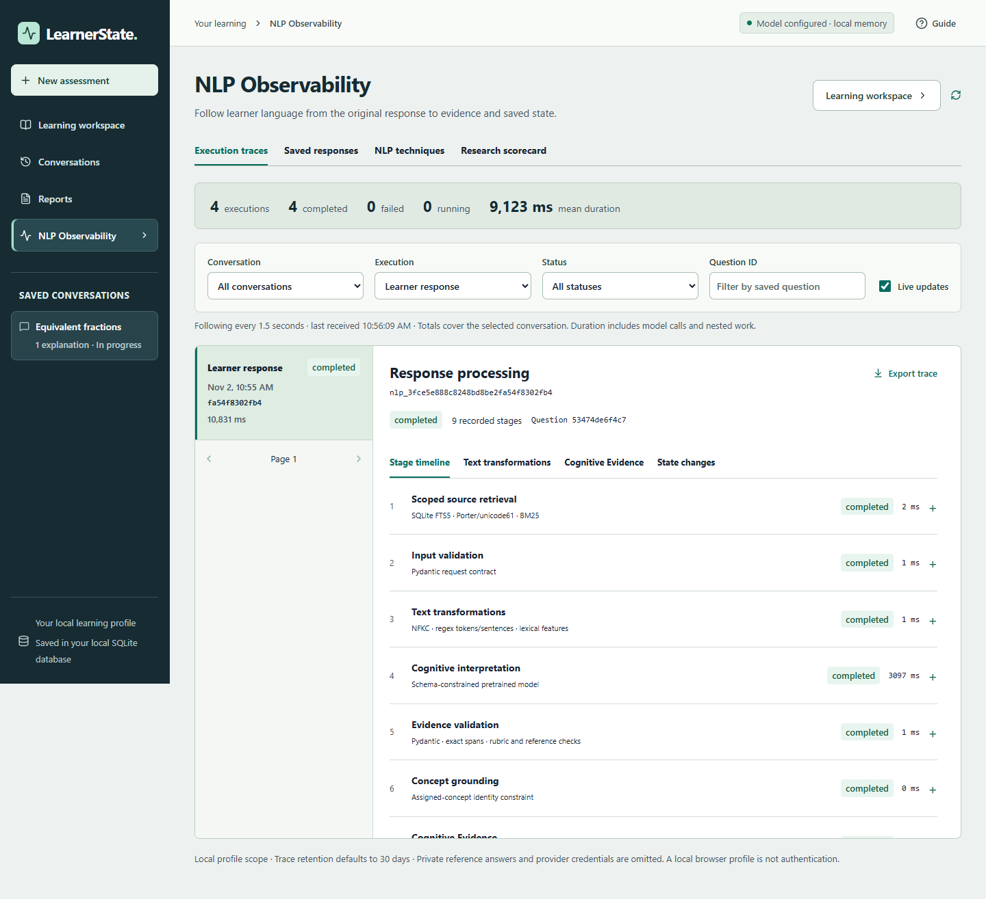
Adaptive planning and NLP Observability
A deterministic policy selects an objective; a model formulates the question.
Rule-based planner
Live execution inspection
Repair: revisit a gap or prerequisite
Diagnose: gather an initial explanation
Verify: check an earlier hypothesis
Transfer: test an idea in a new case
Question generation
The model follows the saved plan and retrieved sources. Rules check target, citations, criteria and novelty.
Selection uses heuristics; no learned policy.
Synthetic live run: stages, timings, retries and errors are inspectable.
Notes:
Sources: packages/learner_state_core/assessment/state.py, execution.py and provider.py; README.md. Screenshot: docs/verification/workspace-feedback/live/desktop-timeline.png, a synthetic live-provider run. Trace collection is best effort.

Slide 10
Status, contributions and next steps
What works today, what is unproven, and what is not active.
Implemented and operational
Built, not yet validated
Not active in v2
Local website and assessment API
NLP preprocessing, FTS5/BM25
GPT-4.1-mini structured extraction
Quoted, grounded Cognitive Evidence
Versioned, atomic learner state
Planner, Observability, evaluation tools
Semantic and misconception accuracy
Confidence and state calibration
Model-authored concept map quality
Effect of planning on question count
Learning gains versus baselines
Dense-vector retrieval
Learned question selection
Calibrated confidence
Production multi-user authentication
General POS / NER pipeline
How we will validate
Untested hypotheses: language adds evidence; structure, grounding and history help; uncertainty reduces overdiagnosis; adaptive selection may reduce questions.
Expert-labelled data
Marks-only / BKT
Text + ablations
Learner evaluation
Notes:
Sources: docs/NLP_CONCEPTS_IMPLEMENTATION_AND_JUSTIFICATION.md, section 8; README.md. Required evaluation includes expert labels, matched correctness-only and raw-text baselines, grounding/history/uncertainty ablations, chronological splits and learner studies. Legacy benchmark prediction horizons differ and do not validate v2.

